Slide 1
CS 566 – Progress Report 1 Parallel Sorting with Load Balancing
Utsav Sharma: usharm4@uic.edu
Meer Shah: mshah229@uic.edu
Jason Pereira: jperei5@uic.edu
Vikram Sah: vsah4@uic.edu

Slide 2
Phases of the Algorithm
Our algorithm works in 5 phases:
Recursive pivoting and distributing the elements among the processors using recursive doubling.
Left to Right loading balancing among the leaves of the recursion tree.
Right to Left loading balancing among the leaves of the recursion tree.
Local sorting.
Writing the output to file using sequential tokens.
Notes:
Meer

Slide 3
Algorithm – Pivoting and Distribution
We are using a recursive doubling approach to distributed the data. The examples here assume that P=8
Step 1: P0 loads the unsorted array into its local memory,
Step 2: P0 partitions the data on the basis of the pivot provided.
Step 3: The (low -> pivot) elements are kept at P0.
Step 4: The (pivot +1 -> high) elements are sent to its partner processor, which is P4 (or P/2^{i}+1 processor).
Notes:
Jason

Slide 4
Algorithm – Pivoting and Distribution
Assuming a hypercube topology, steps 2 to 4 are repeated by the active processors in each iteration of the algorithm, till all P processors have a portion of the array.
Since we are assuming a hypercube topology, this distribution would complete in log P iterations.
Performing the pivoting and distribution in this manner instead of sequentially ensures that we are not bottlenecked by the sequential distribution on P0, which would then take another P-1 communication steps to send the data to the other P-1 processors.
Notes:
Jason

Slide 5
Algorithm – Pivoting and Distribution
P0
P0
P4
P0
P2
P4
P6
P0
P1
P2
P3
P4
P5
P6
P7
Notes:
Jason

Slide 6
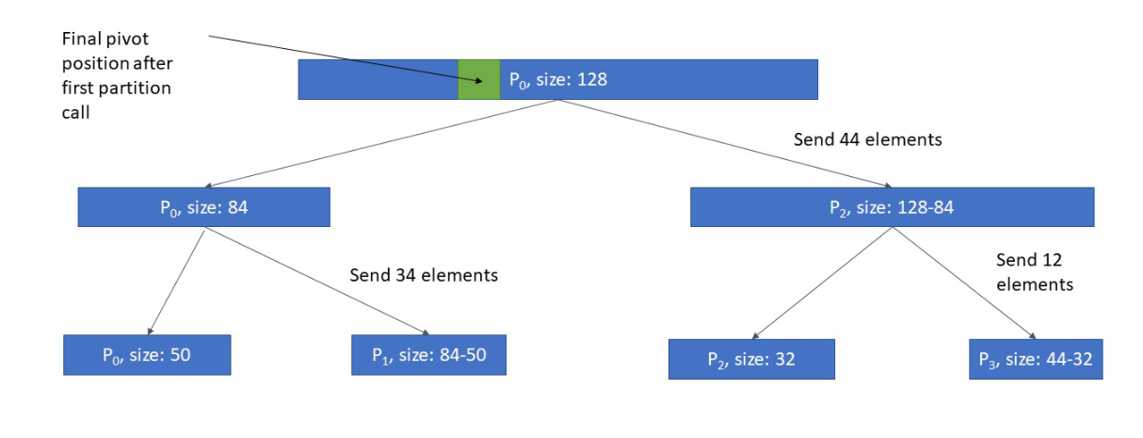
Algorithm – Pivoting and Distribution
Distributing the algorithm in this manner guarantees that the subarrays being distributed to each processor are ordered from smallest to largest going from P0 to P-1.
This is because once the pivot is chosen, the elements in the array at each processor in each iteration are arranged as smaller or larger than the array, and then the higher portion of the array is sent to my_id+1.
This ensures that when the local arrays are sorted and written to file, the ordering of the numbers is maintained.
Notes:
Jason

Slide 7
Algorithm – Load Balancing
The Load Balancing kicks in after log P steps of data distribution among all the P processors is completed.
This step calculates an optimal length of subarrays within each processor such as:
Optimal Size = totalElements/totalProcessors
The processor Pi calculates its extra elements (ee) such that
ee = len(LocalsArr) - Optimal Size
And send its largest 'ee' elements to its neighbor P_{i+1} as a message passing step.
Notes:
Vikram

Slide 8
Algorithm – Load Balancing
We repeat the above steps till there are optimal number of elements in the local arrays of all the processors P_{i} to P_{N}
In case the final processor Pn ends up having elements more than the optimal size, the smallest 'ee' elements in Pn is sent back to the Procs P_{n-1}in a series of message passing steps until all the elements are equalized.
To compensate for the message passing time we also use a dynamic threshold value along with the optimal array size which is discussed later.
Notes:
Vikram

Slide 9
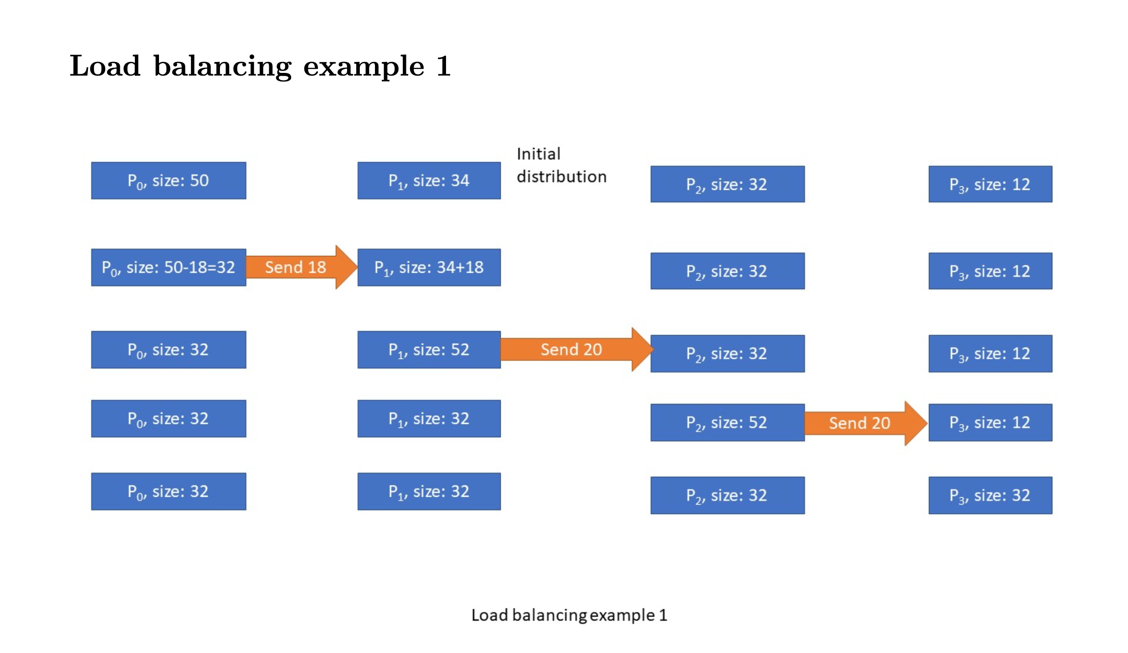
Algorithm – Load Balancing
Notes:
Vikram

Slide 10
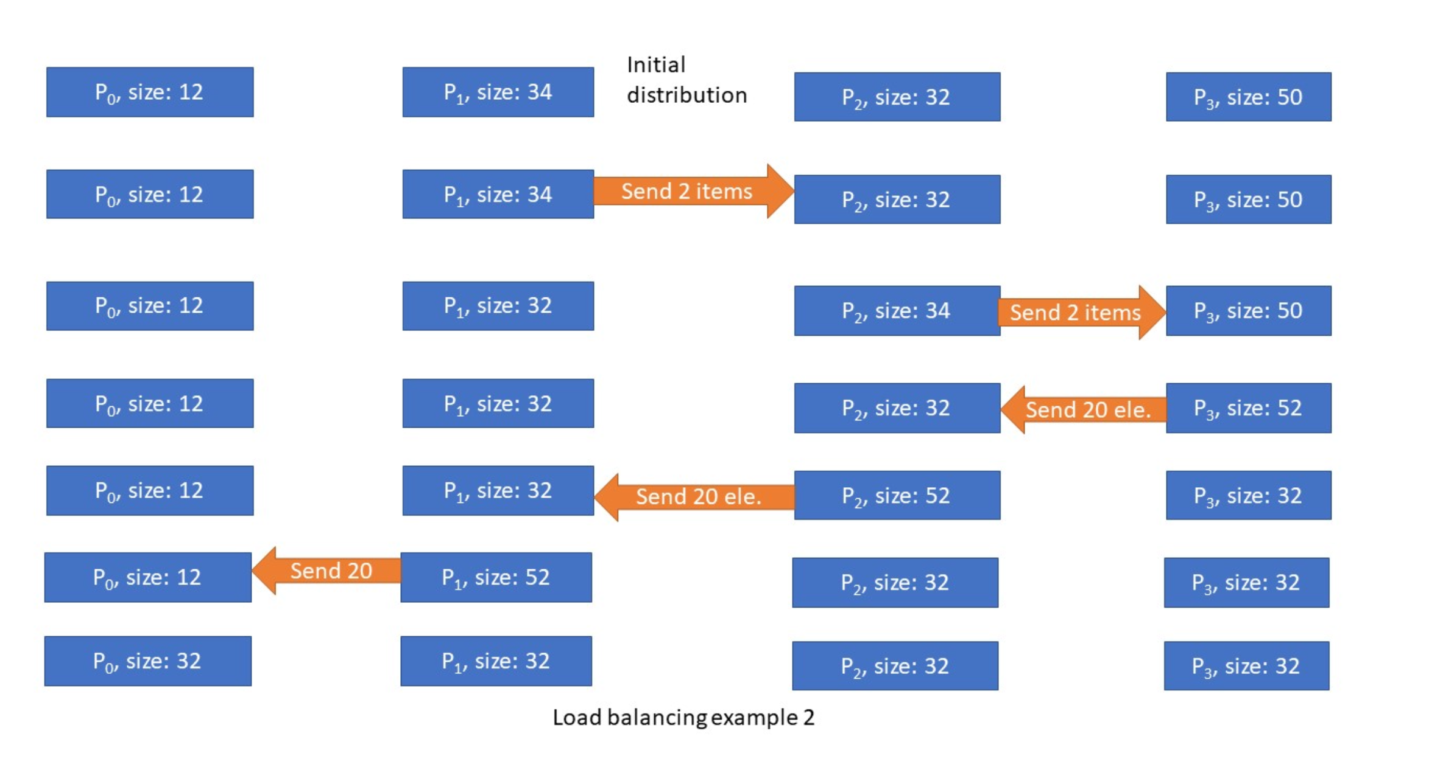
Algorithm – Load Balancing
Notes:
Vikram

Slide 11
Algorithm - Local Insertion Sort
When the data is distributed to all the leaf nodes and the load is balanced across all the processors, we perform insertion sort on each local subarray.
It is to be noted that at this point element P^{i}_{largest} < P^{i+1}_{smallest}
In this algorithm the lower part of an array is maintained to be sorted. An element which is to be inserted in this sorted sub-list, has to find its appropriate place and then it has to be inserted there.
Notes:
skip

Slide 12
Algorithm – Writing to File
To write the output to the file, we use a token based system where P0 opens the file, writes its output and closes the file. It then passes the token to my_id+1.
This process is then repeated at all the other processors in order, till we reach P-1.
Notes:
skip

Slide 13
Time Complexity Analysis
Distribution Time – O(c N log(p))
Load Balancing Time – O ( P N log N)
Sending Elements – O(NP)
Merge Time – O(NP)
Finding K minimum/maximum elements – O(P N log N)
Removing Extra Elements – O (NP)
Notes:
Meer

Slide 14
Features and Drawbacks
Constraints:
A processor can only send elements to its neighbors
However, regular neighborhood averaging, will only provide local load balancing.
This algorithm
Results in a globally balanced load
Preserves the partial ordering of elements
Drawback:
Useless, on the worst case, where load balancing time >= processing time
"Worst case" is when load balancing should be the most useful
Possible Optimizations:
Notes:
Meer

Slide 15
Optimization
To optimize the load balancing phase further, we are looking at splitting the calculation of the number of elements to send and the actual sending of the elements of the subarrays.
Currently, the load balancing takes P-1 steps in each direction as described earlier.
To reduce the time this would take, the approach we are considering would perform the calculation of the number of elements to send, and send that to its partner processor in a separate step.
Notes:
Utsav

Slide 16
Optimization
Once a processor receives this information from its partner, the processor would perform its own calculation of extra elements based on the knowledge of how many elements it is going to receive, and how many elements it has right now.
This step has some minor sequentialization, since a processor must wait till it receives this information from its partner, but the load balancing would take fewer steps in general to achieve the same result.
Once all processors have completed this step, the sending of the extra elements would happen in parallel.
This is possible because the elements being received will be lower than the lowest current element in our local subarray, while the elements being sent will be from the higher half of the local subarray (going left to right).
Notes:
Utsav

Slide 17
Optimization
There is a possibility that a processor does not have enough elements to send, in which case it would not participate in this iteration of the load balancing.
To ensure that we have sufficient load balancing and do not miss any imbalance, this entire process would be repeated till all processors have extra elements that are >= a dynamic threshold (e.g. 20% of N/P elements). This threshold ensures that we do not spend too much time trying to balance the load.
After the threshold is reached at all processors, there will be no more messages sent with the number of extra elements.
The load balancing would then proceed in the reverse direction.
Notes:
Utsav

Slide 18
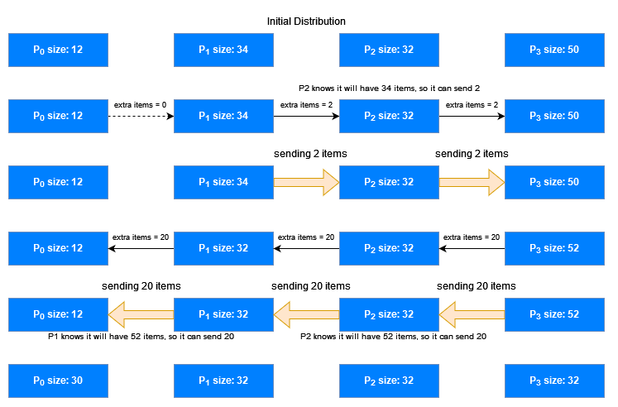
Optimization
Notes:
Utsav

Slide 19
Optimization
This method eliminates the need to do 2(P-1) passes of the load balancing.
In this manner, we would achieve a more even and efficient load balancing, where each processor is aware of its eventual load after it receives the extra elements when it is making the decision of the number of its extra elements to send.
Notes:
Utsav

Slide 20


Programming Progress
Recursive pivoting and distributing the elements among the processors using recursive doubling.
Left to Right loading balancing among the leaves of the recursion tree.
Right to Left loading balancing among the leaves of the recursion tree.
Local sorting.
Writing the output to file using sequential tokens.
Notes:
Jason

Slide 21
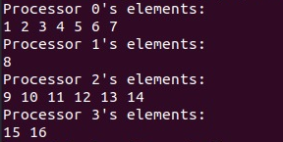
Programming Progress
This screenshot shows the output from the processors after local sorting.
The input array is given to P0 as {2,15,14,3,12,11,1,9,16,7,6,5,4,13,10,8}
Our code right now performs the steps of recursive pivoting, local sorting and writing the output using a token.
The pivot has been taken as the middle element of the array.
As you can see, each processor ends up with unequal number of elements using recursive pivoting.
Notes:
Jason

